Slide 1
Mean Firing Rates
Normal vs PD
50
Mean Firing Rates Bar Plots
40
FSN
50
Normal
40
MSND1
30
PD
MSND2
40
30
30
Firing Rates
Firing Rates
STN
20
20
Prototypic
20
Arkypallidal
10
10
10
SNr
0
0
0
1
2
N
c
r
SN
D
D
i
SN
0
5000
10000
1
2
N
c
r
F
ST
p
SN
D
D
i
SN
ty
F
ST
p
MSN
MSN
ty
to
MSN
Arkypallidal
Ti
MSN
to
me
Arkypallidal
o
o
Pr
Pr
Hours
Normal vs PD
40
Normal
30
PD
Firing Rates
20
10
0
1
2
c
r
SN
D
D
N
i
SN
F
ST
p
MSN
MSN
ty
to
Arkypallidal
o
Pr
Neuron

Slide 2
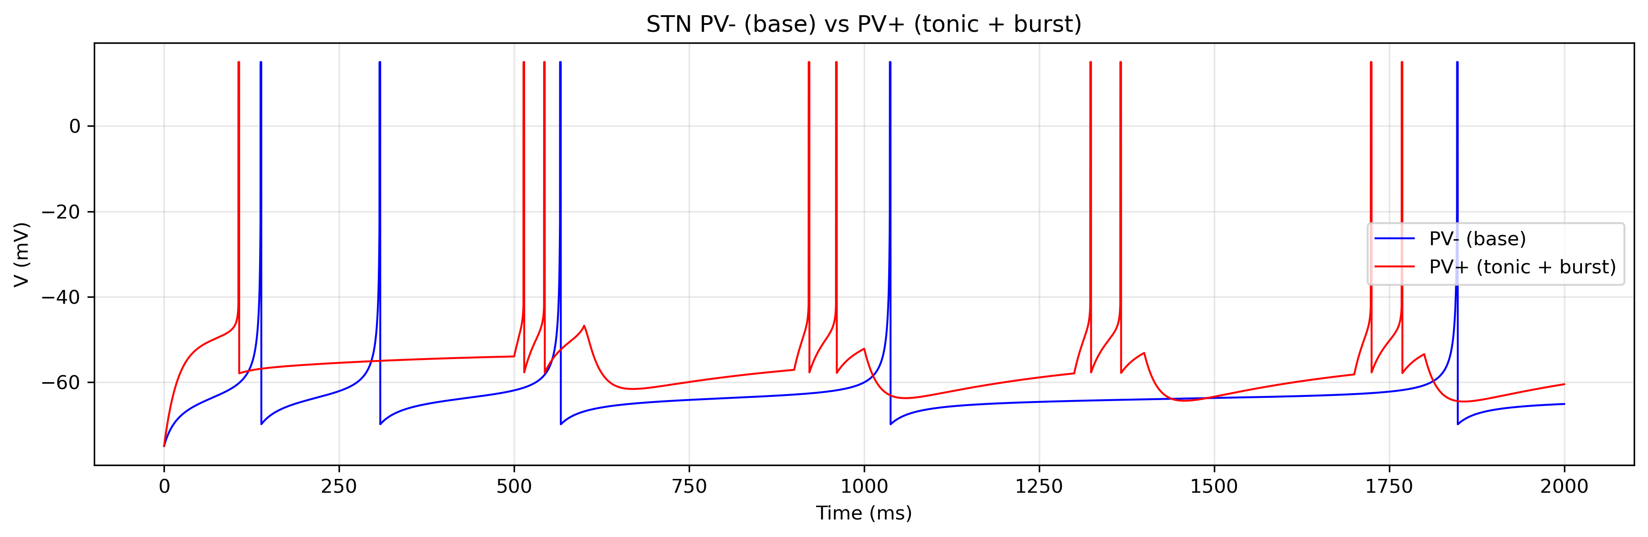
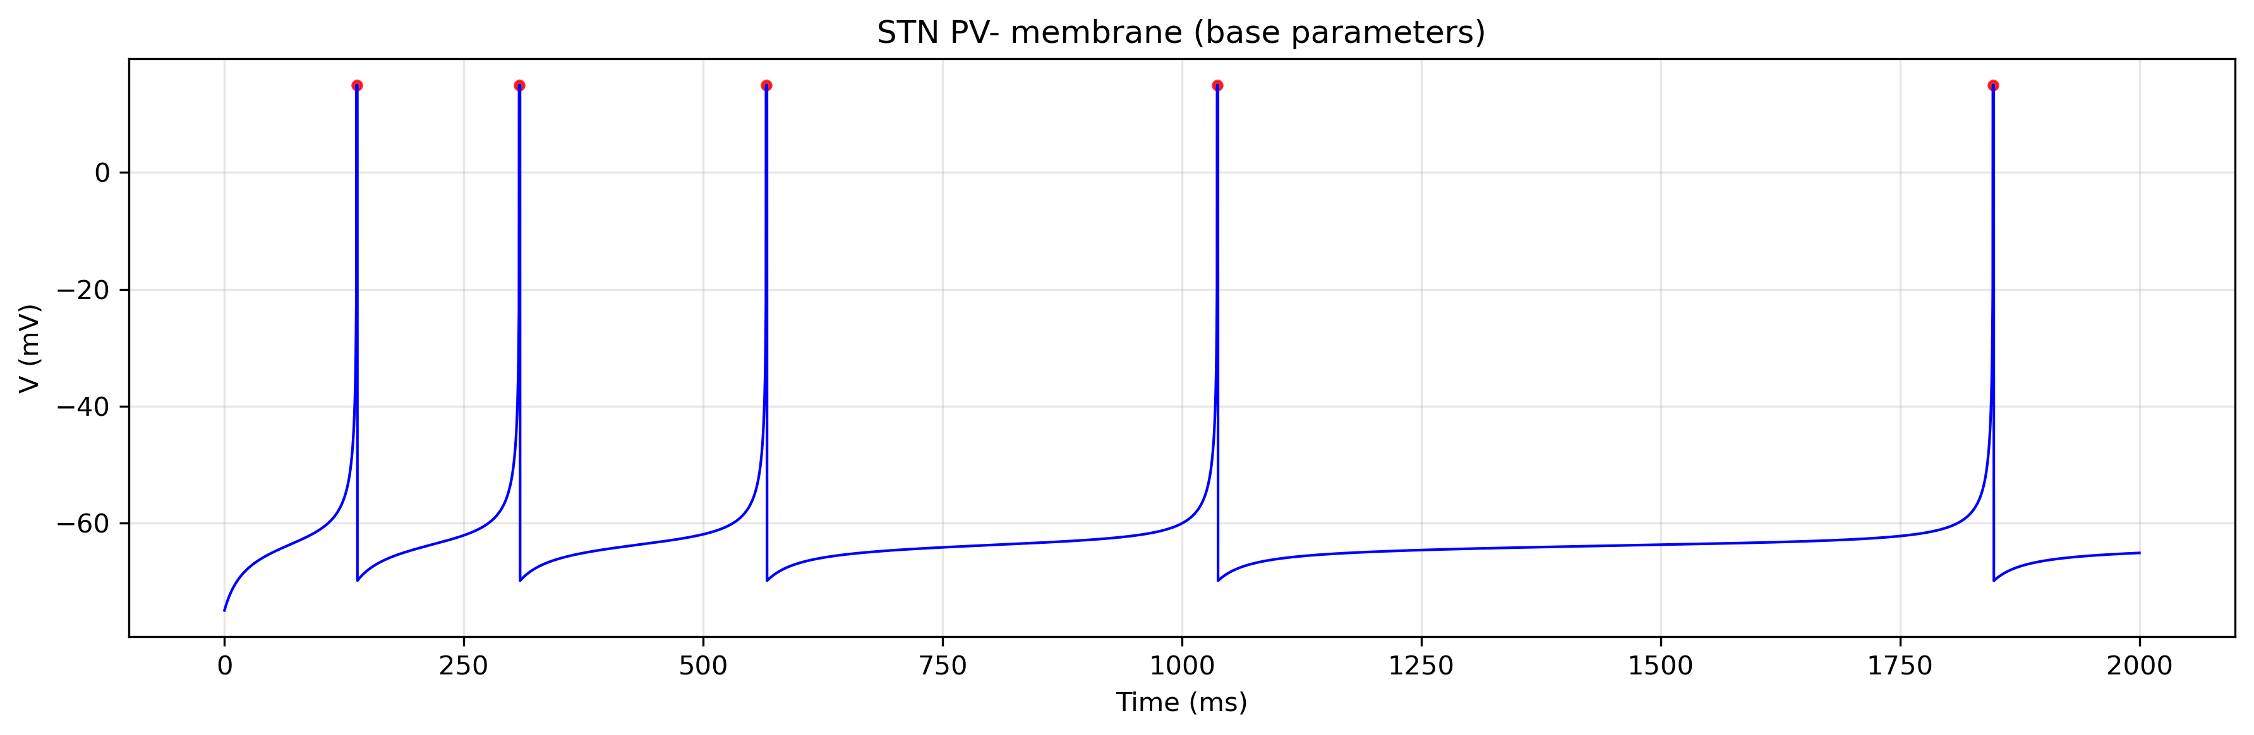
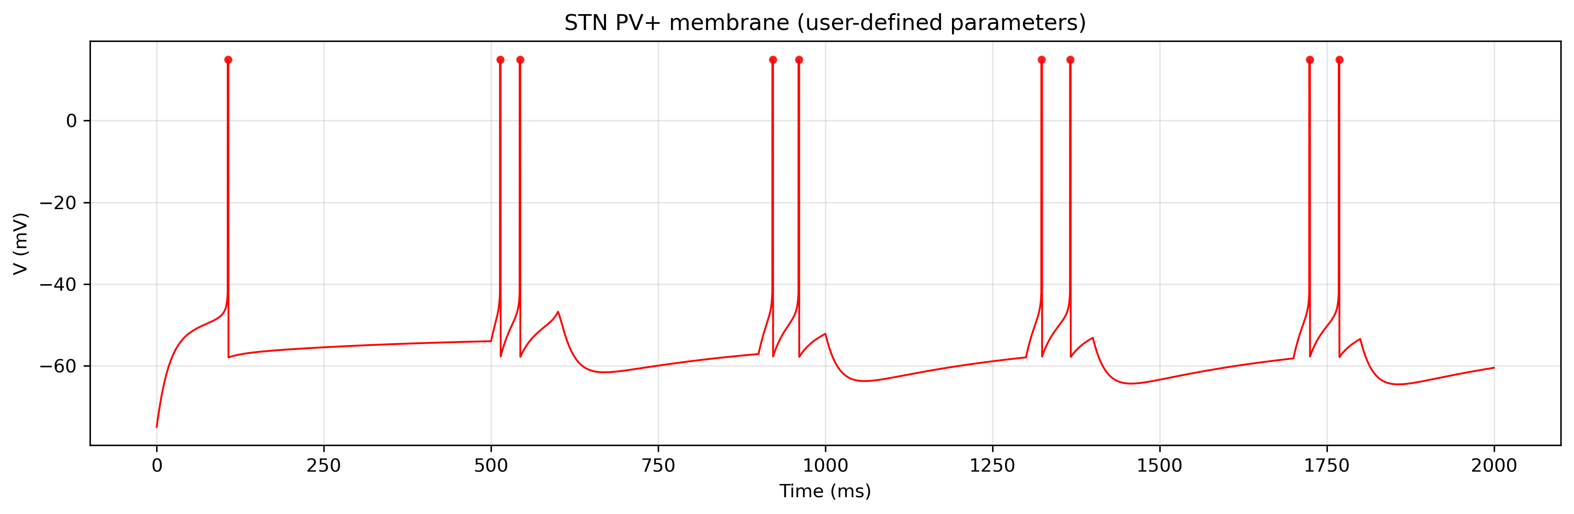

Slide 3
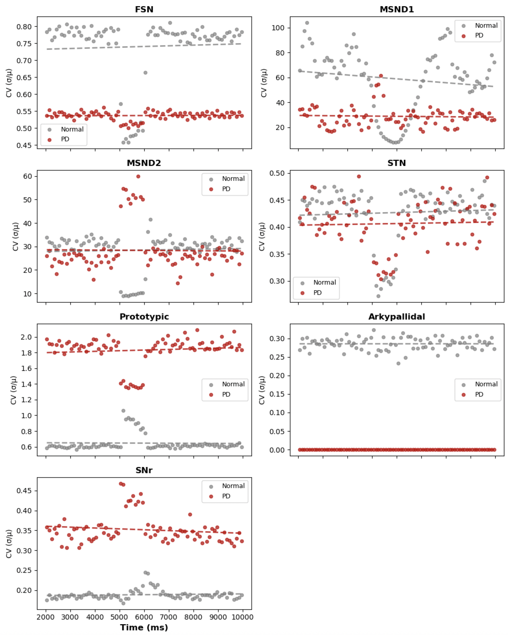

Slide 4
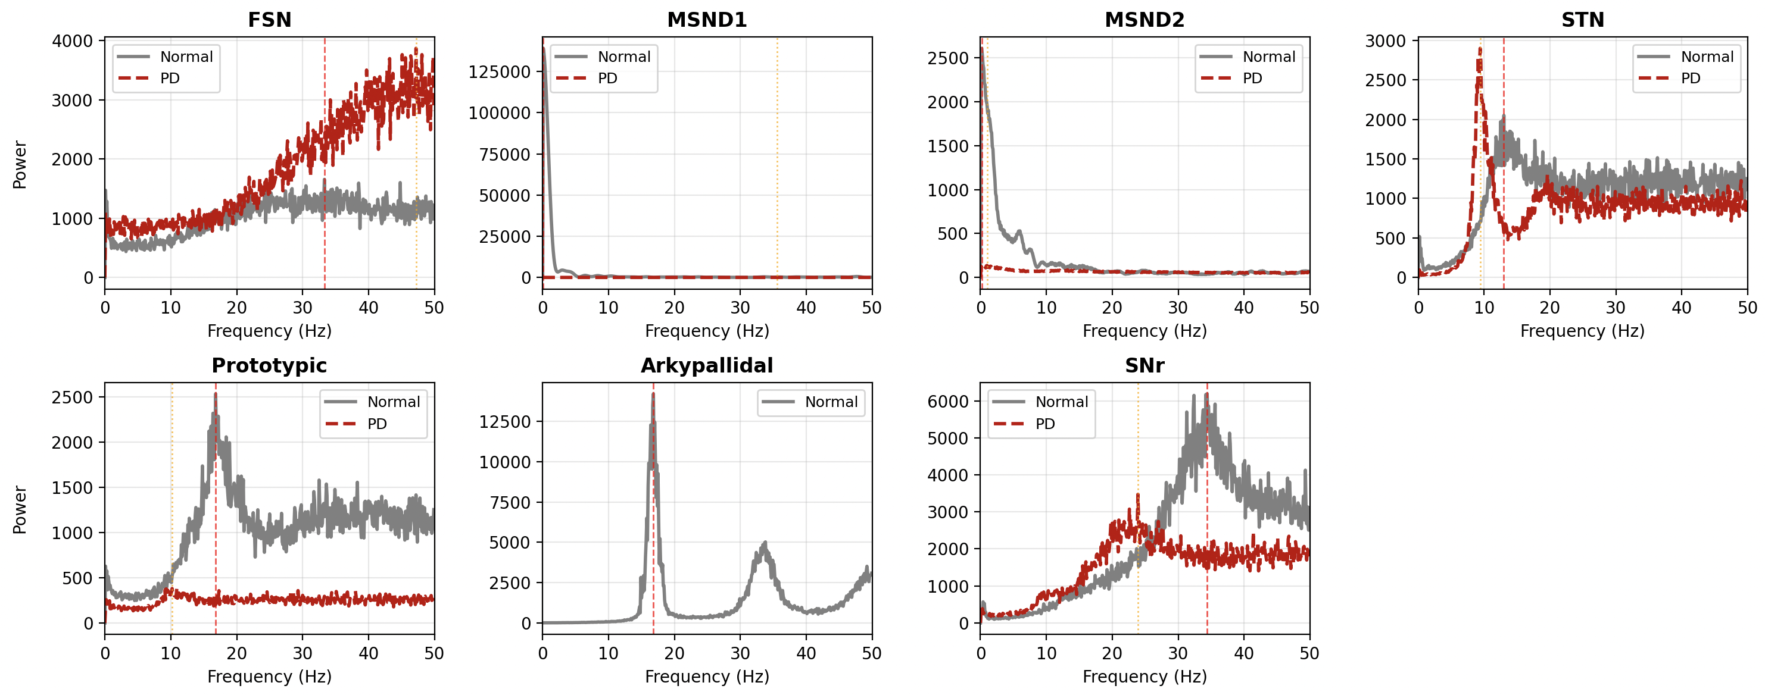

Slide 5
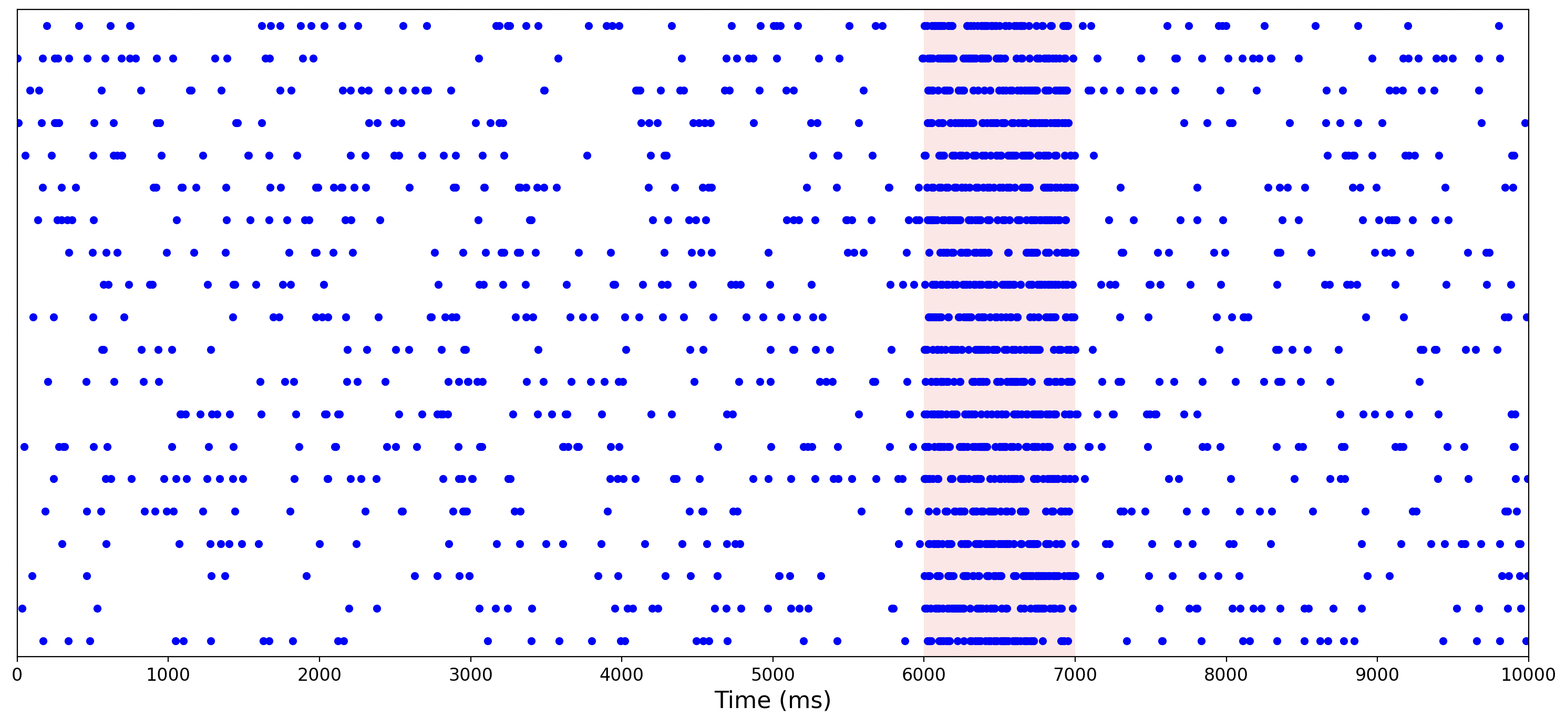
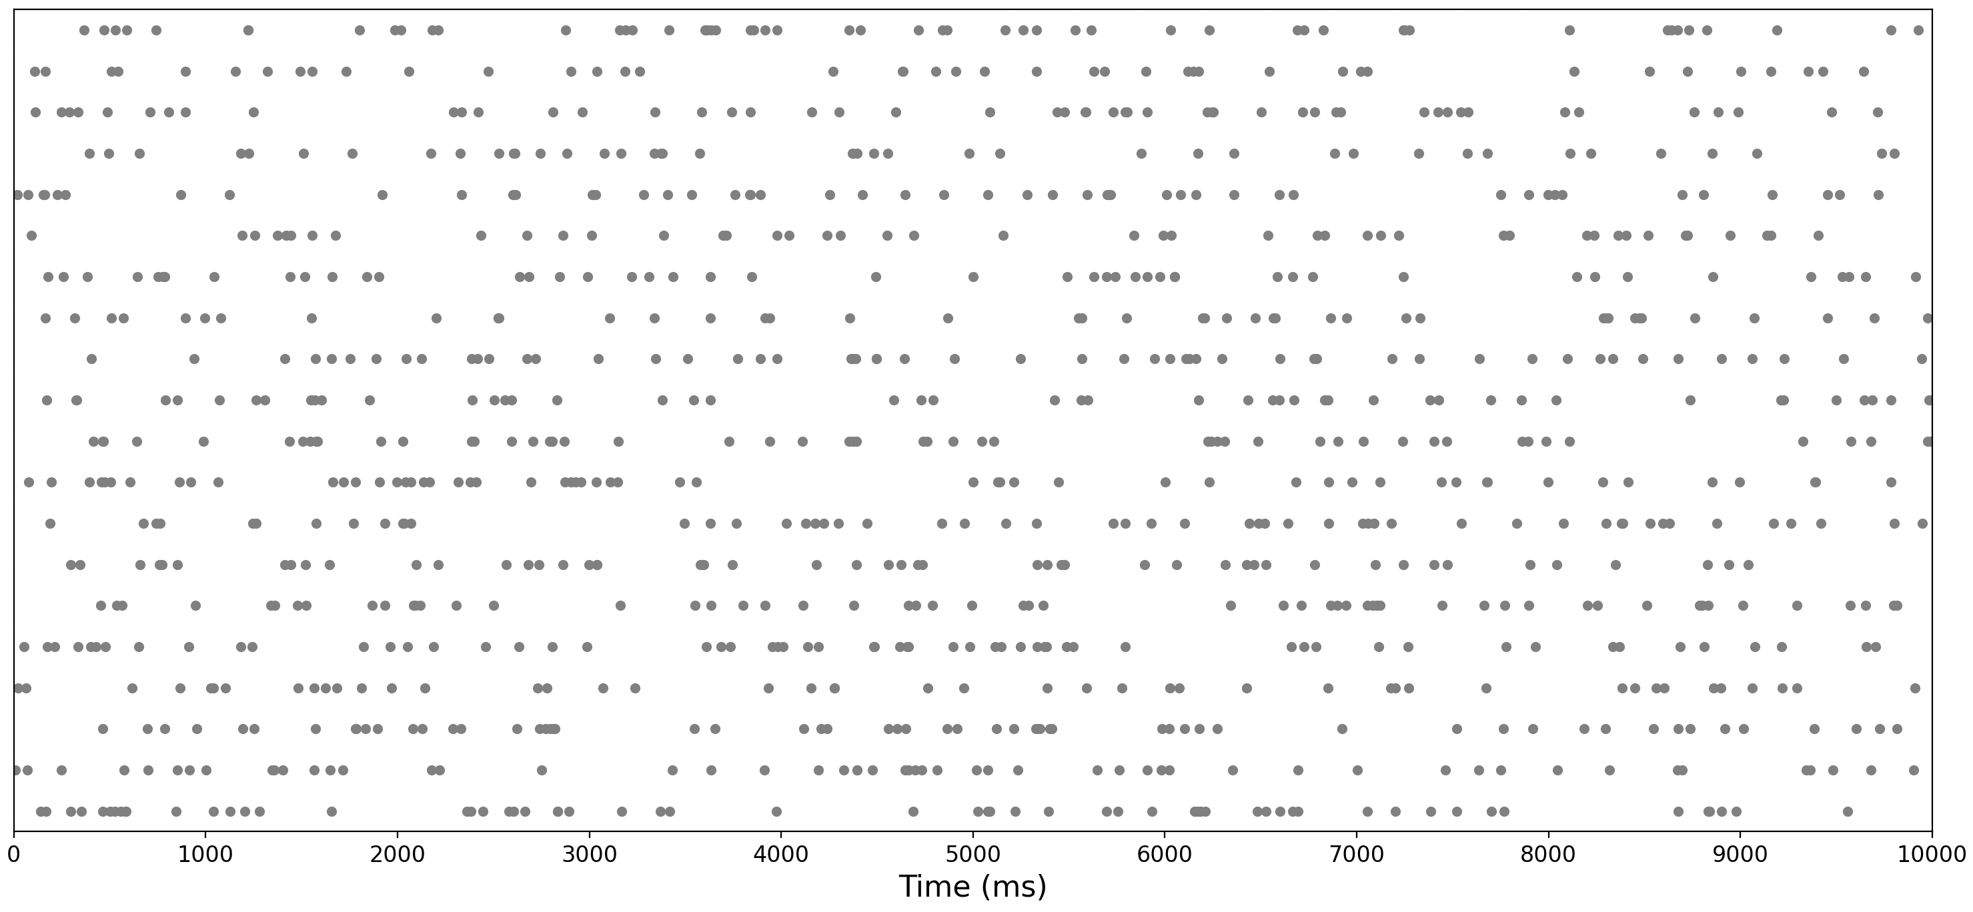

Slide 7
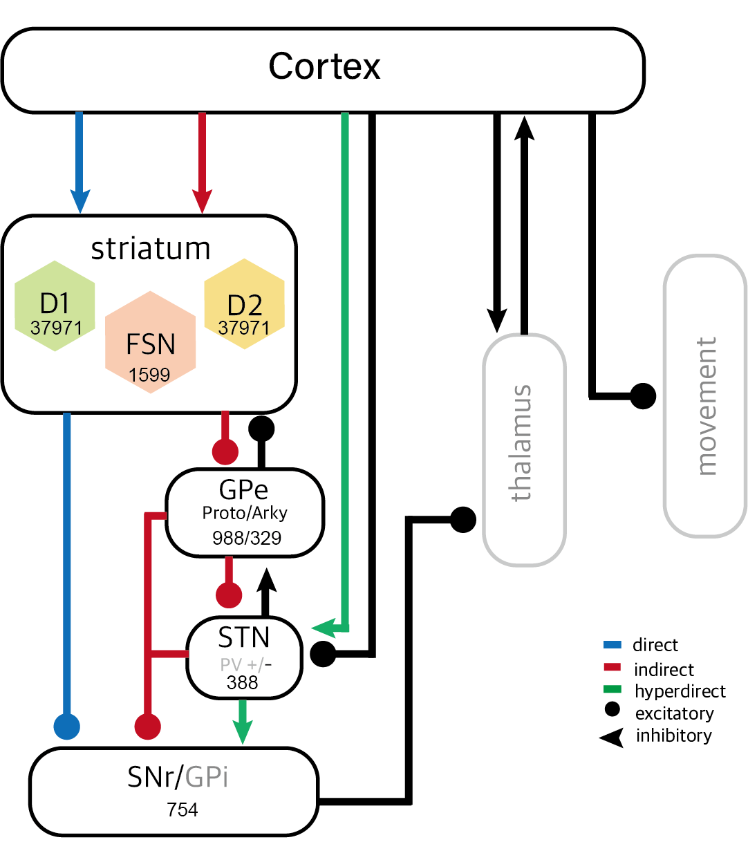
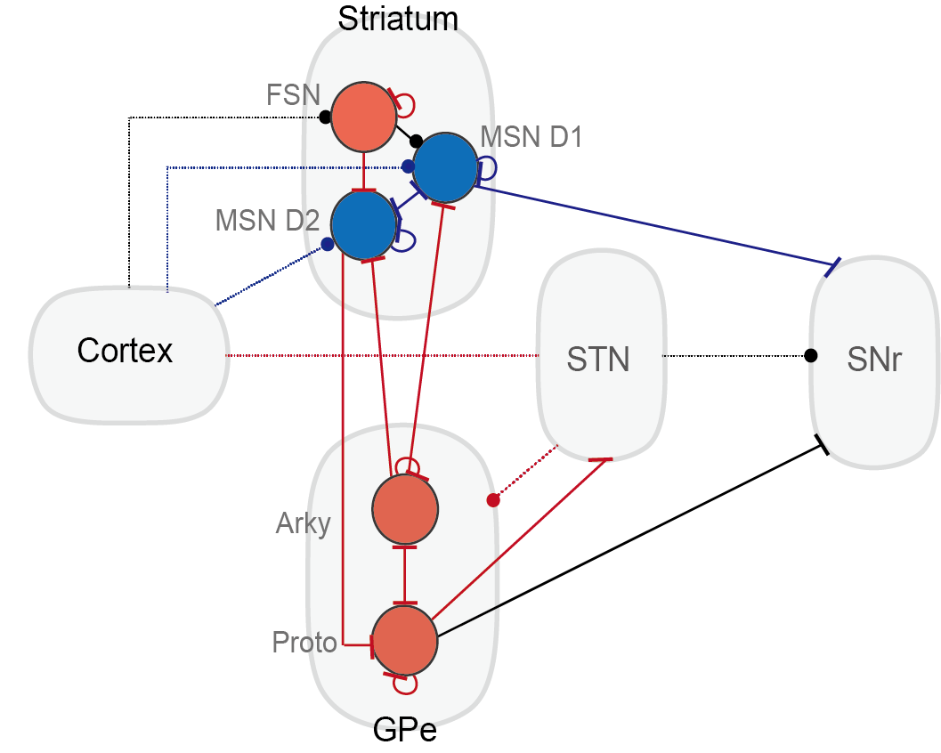

Slide 8
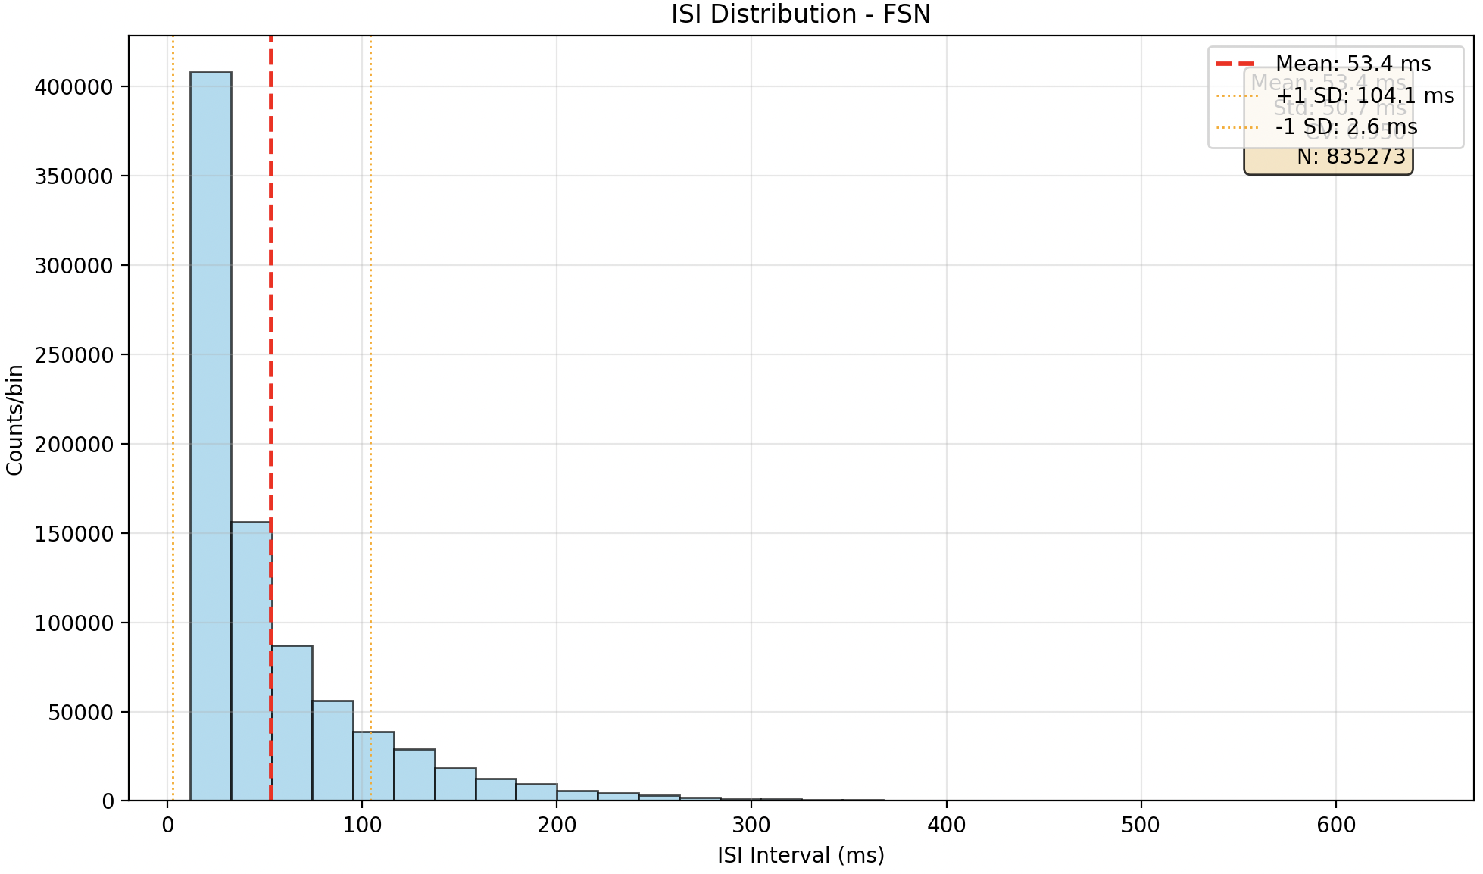
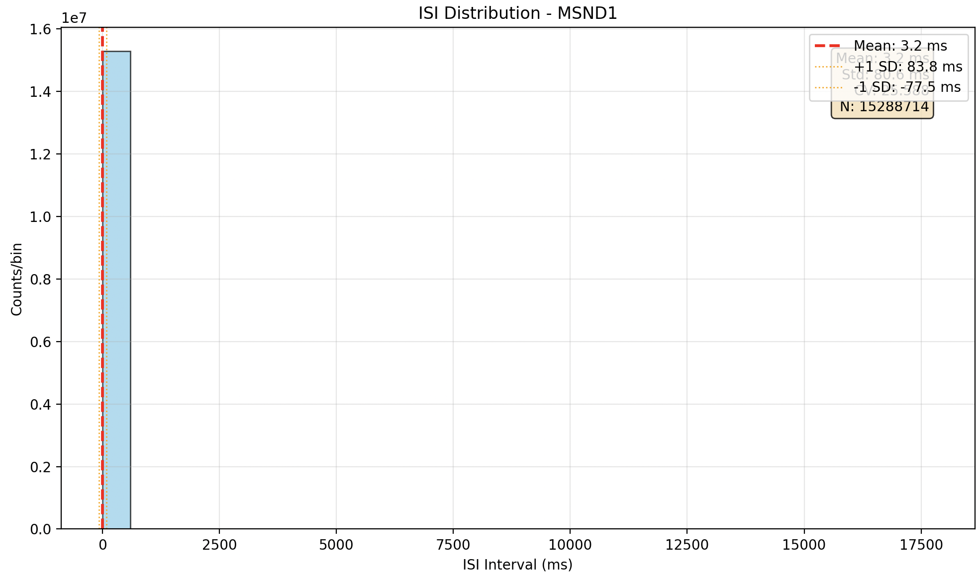
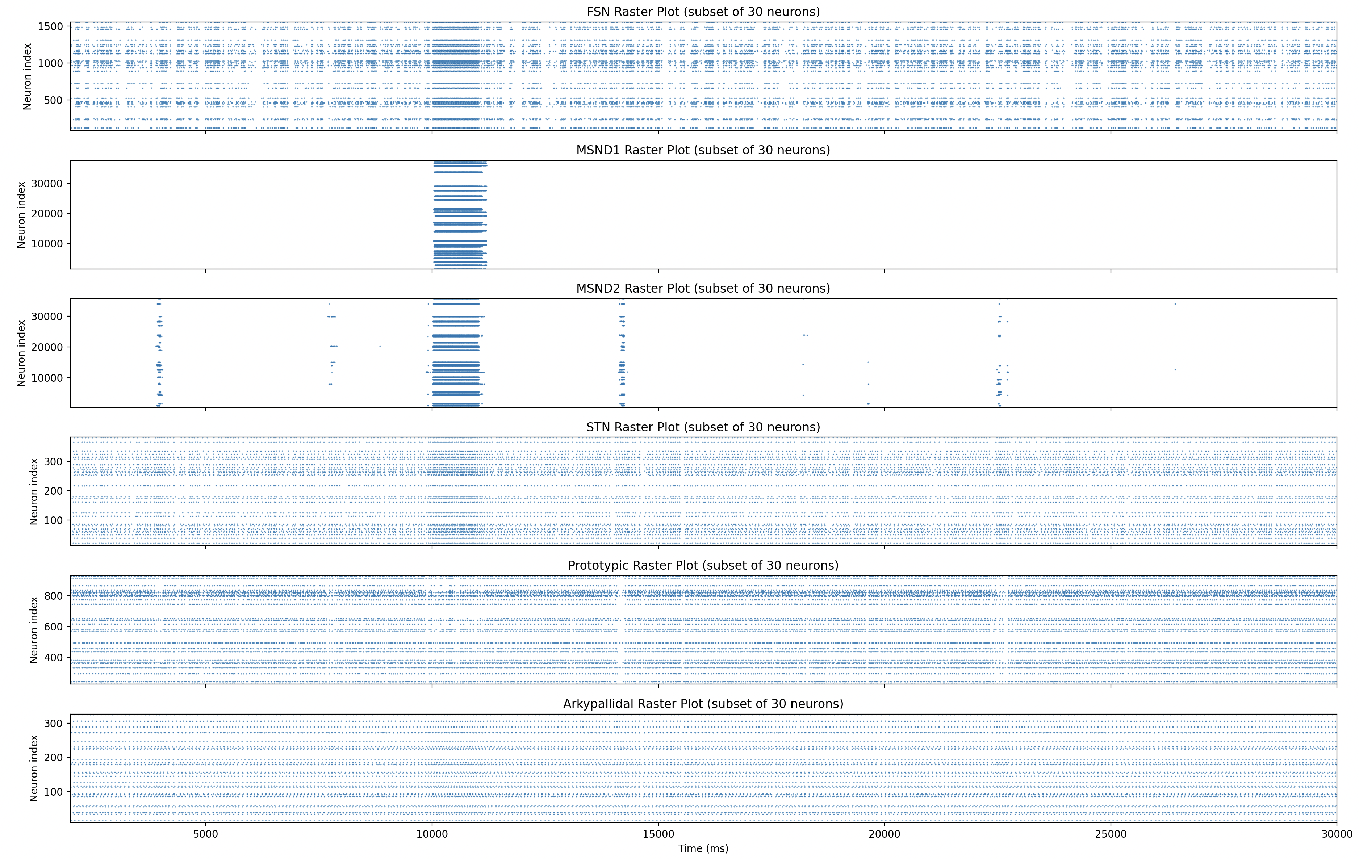
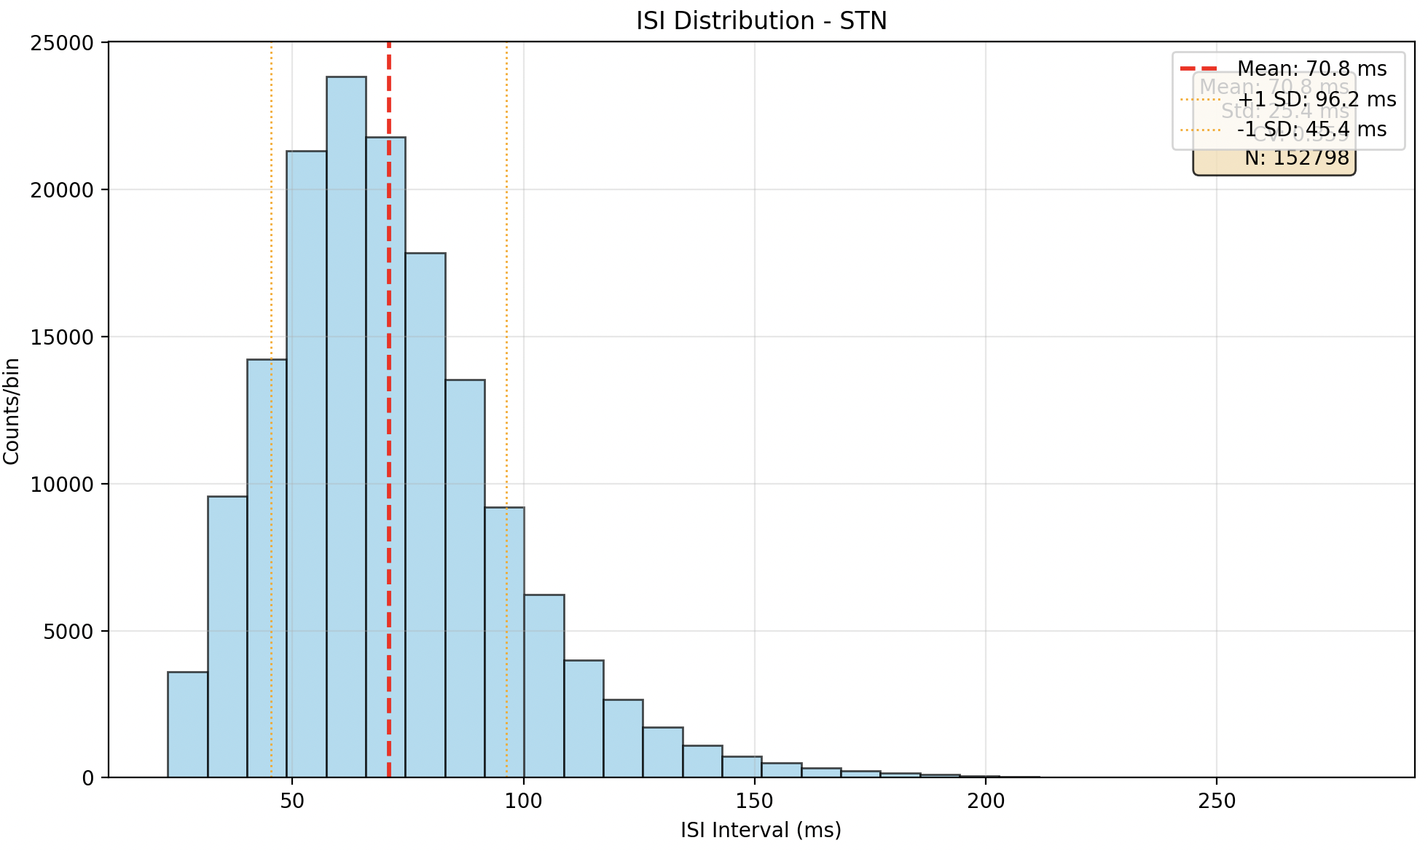
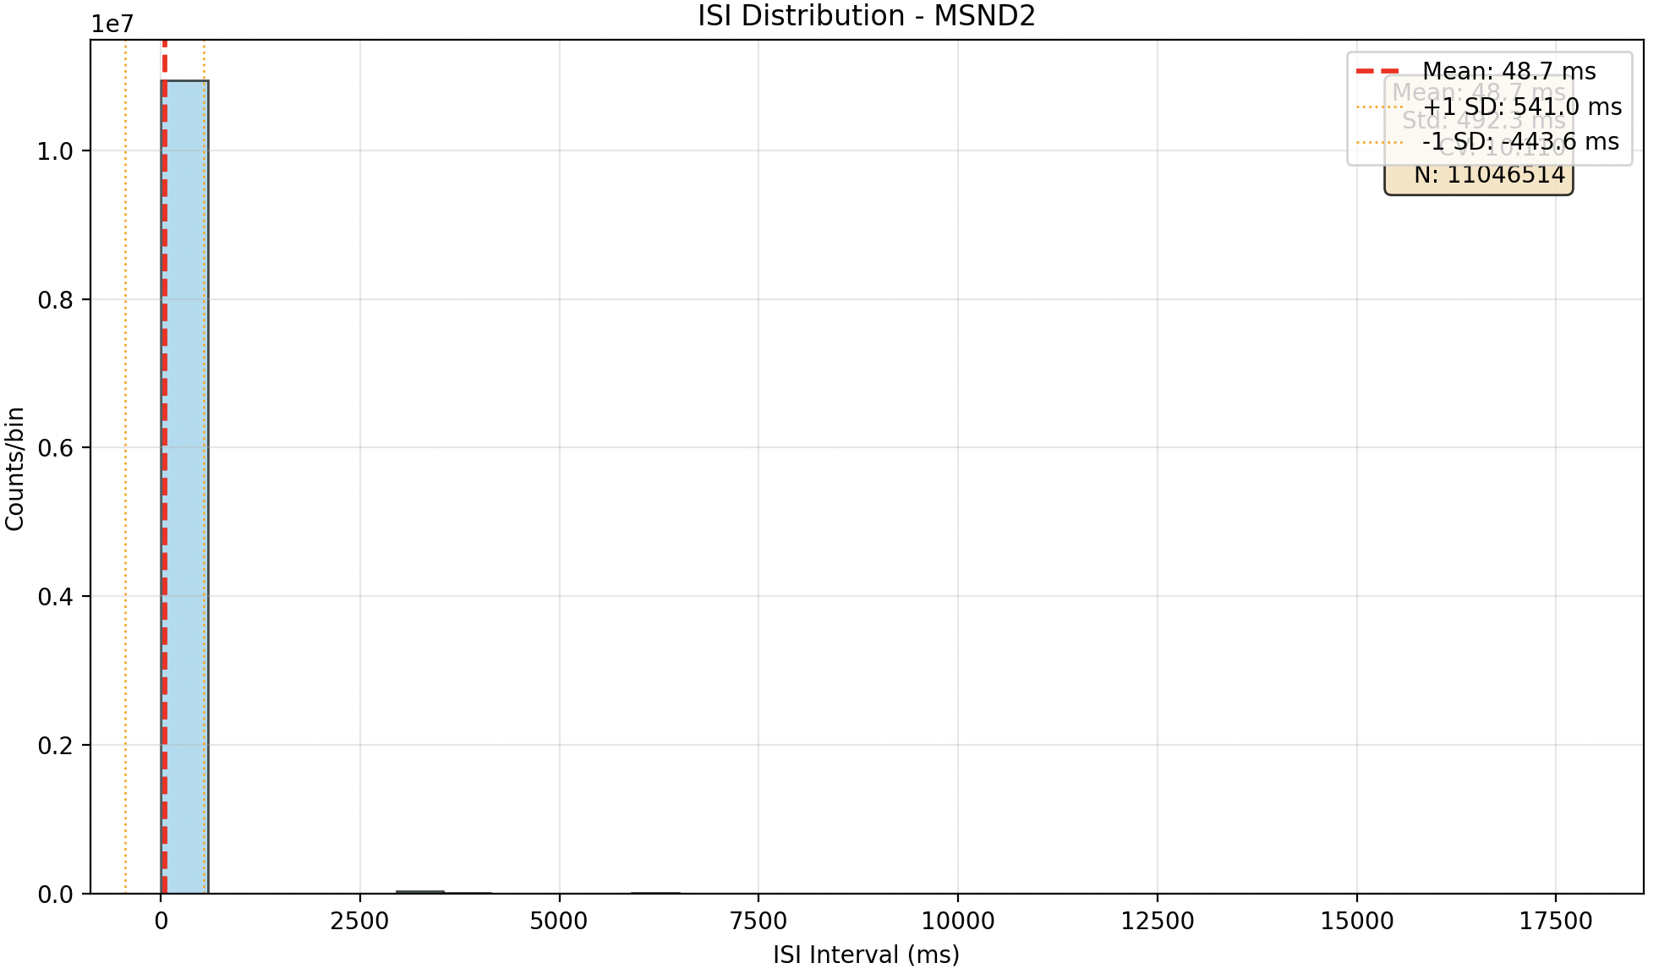
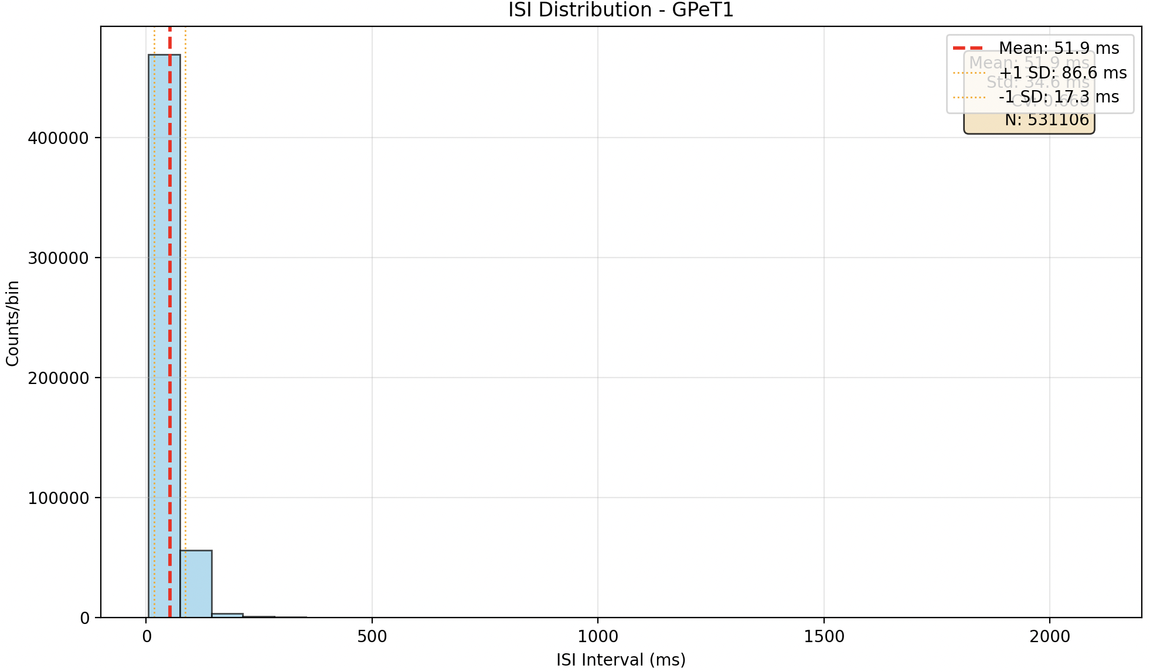
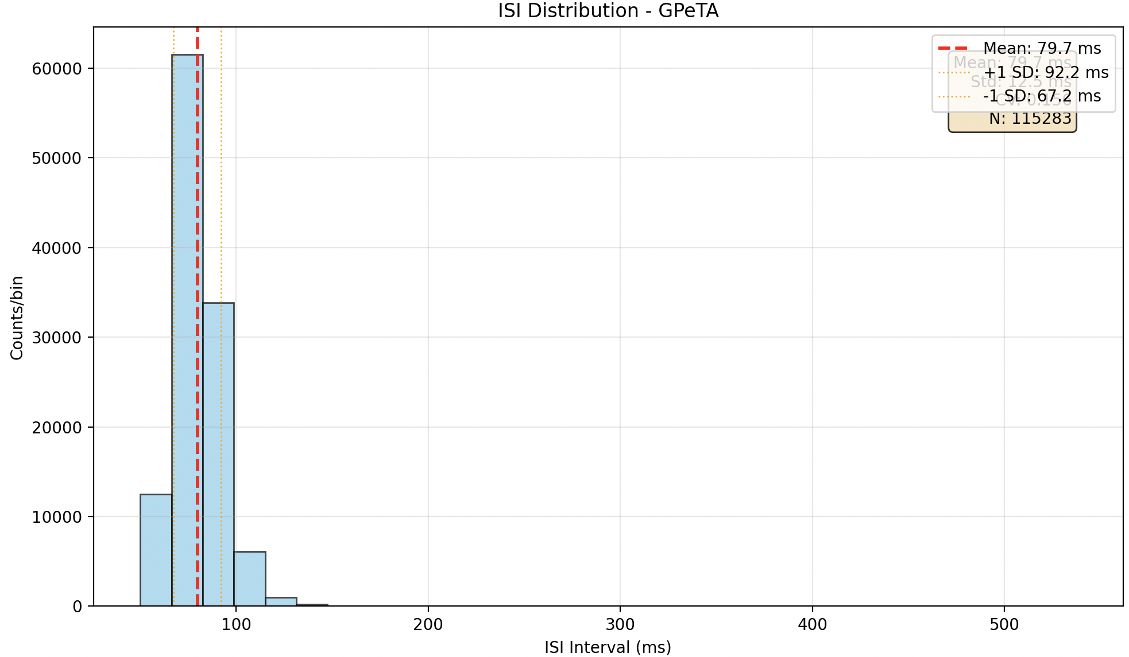
예전 결과들
250707
Normal (1s stimulus)

Slide 9
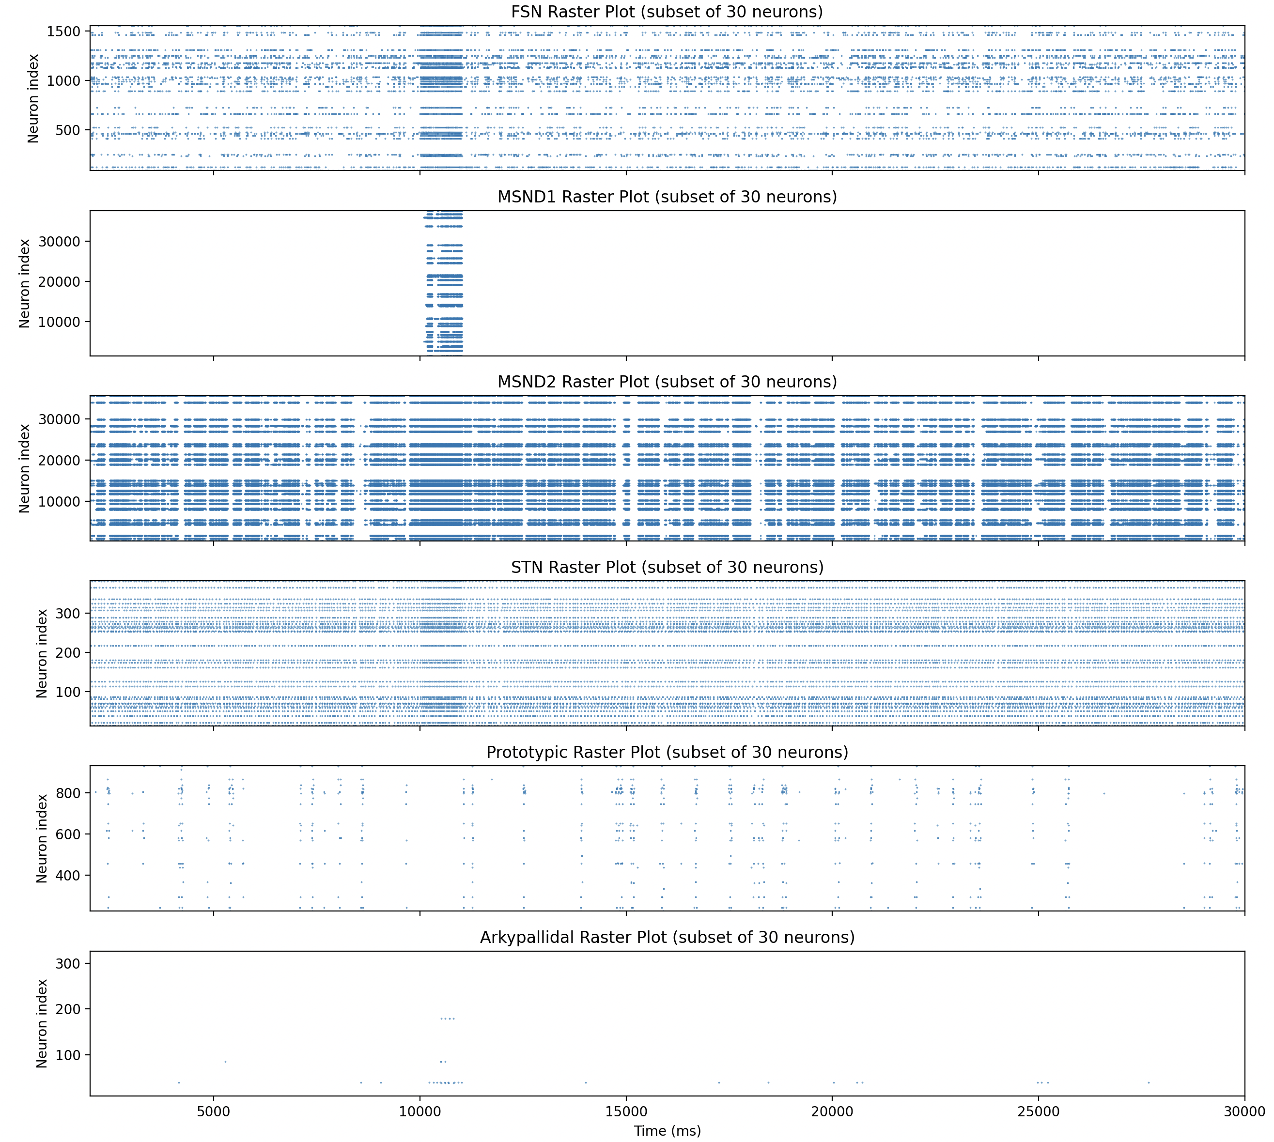
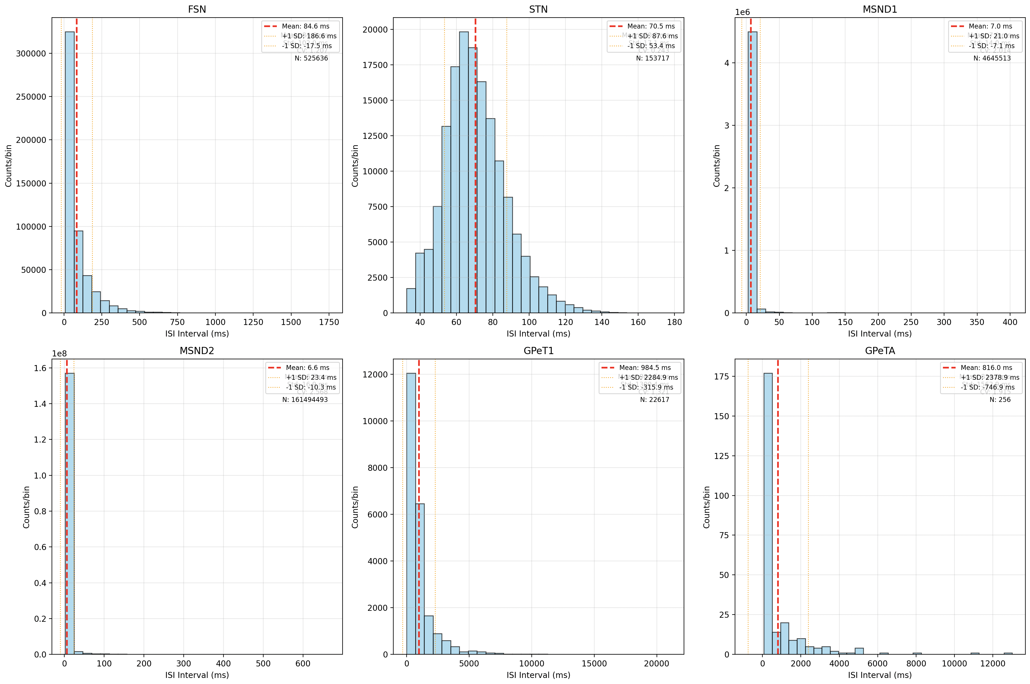
예전 결과들
250707
PD (1s stimulus)

Slide 10
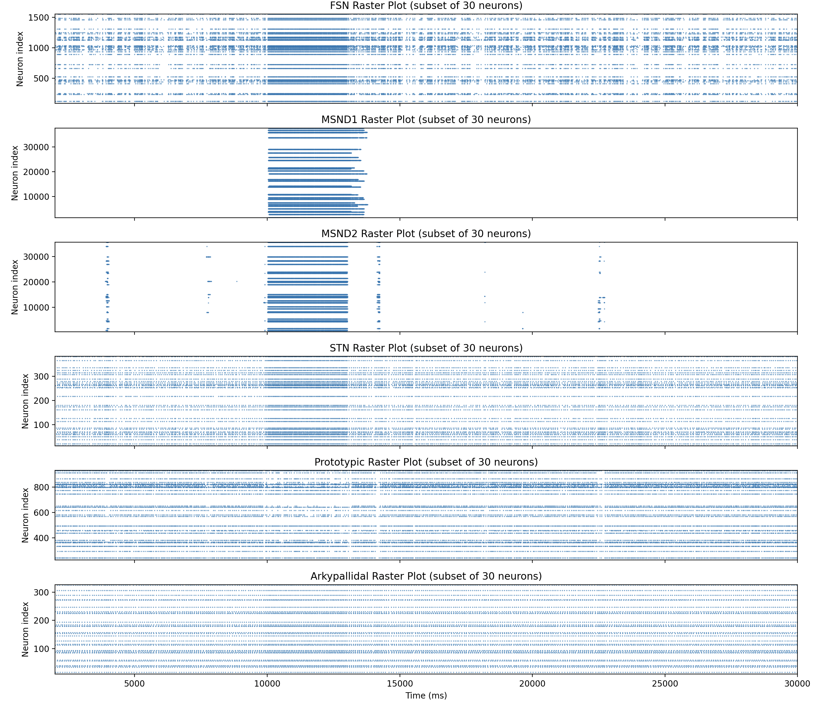
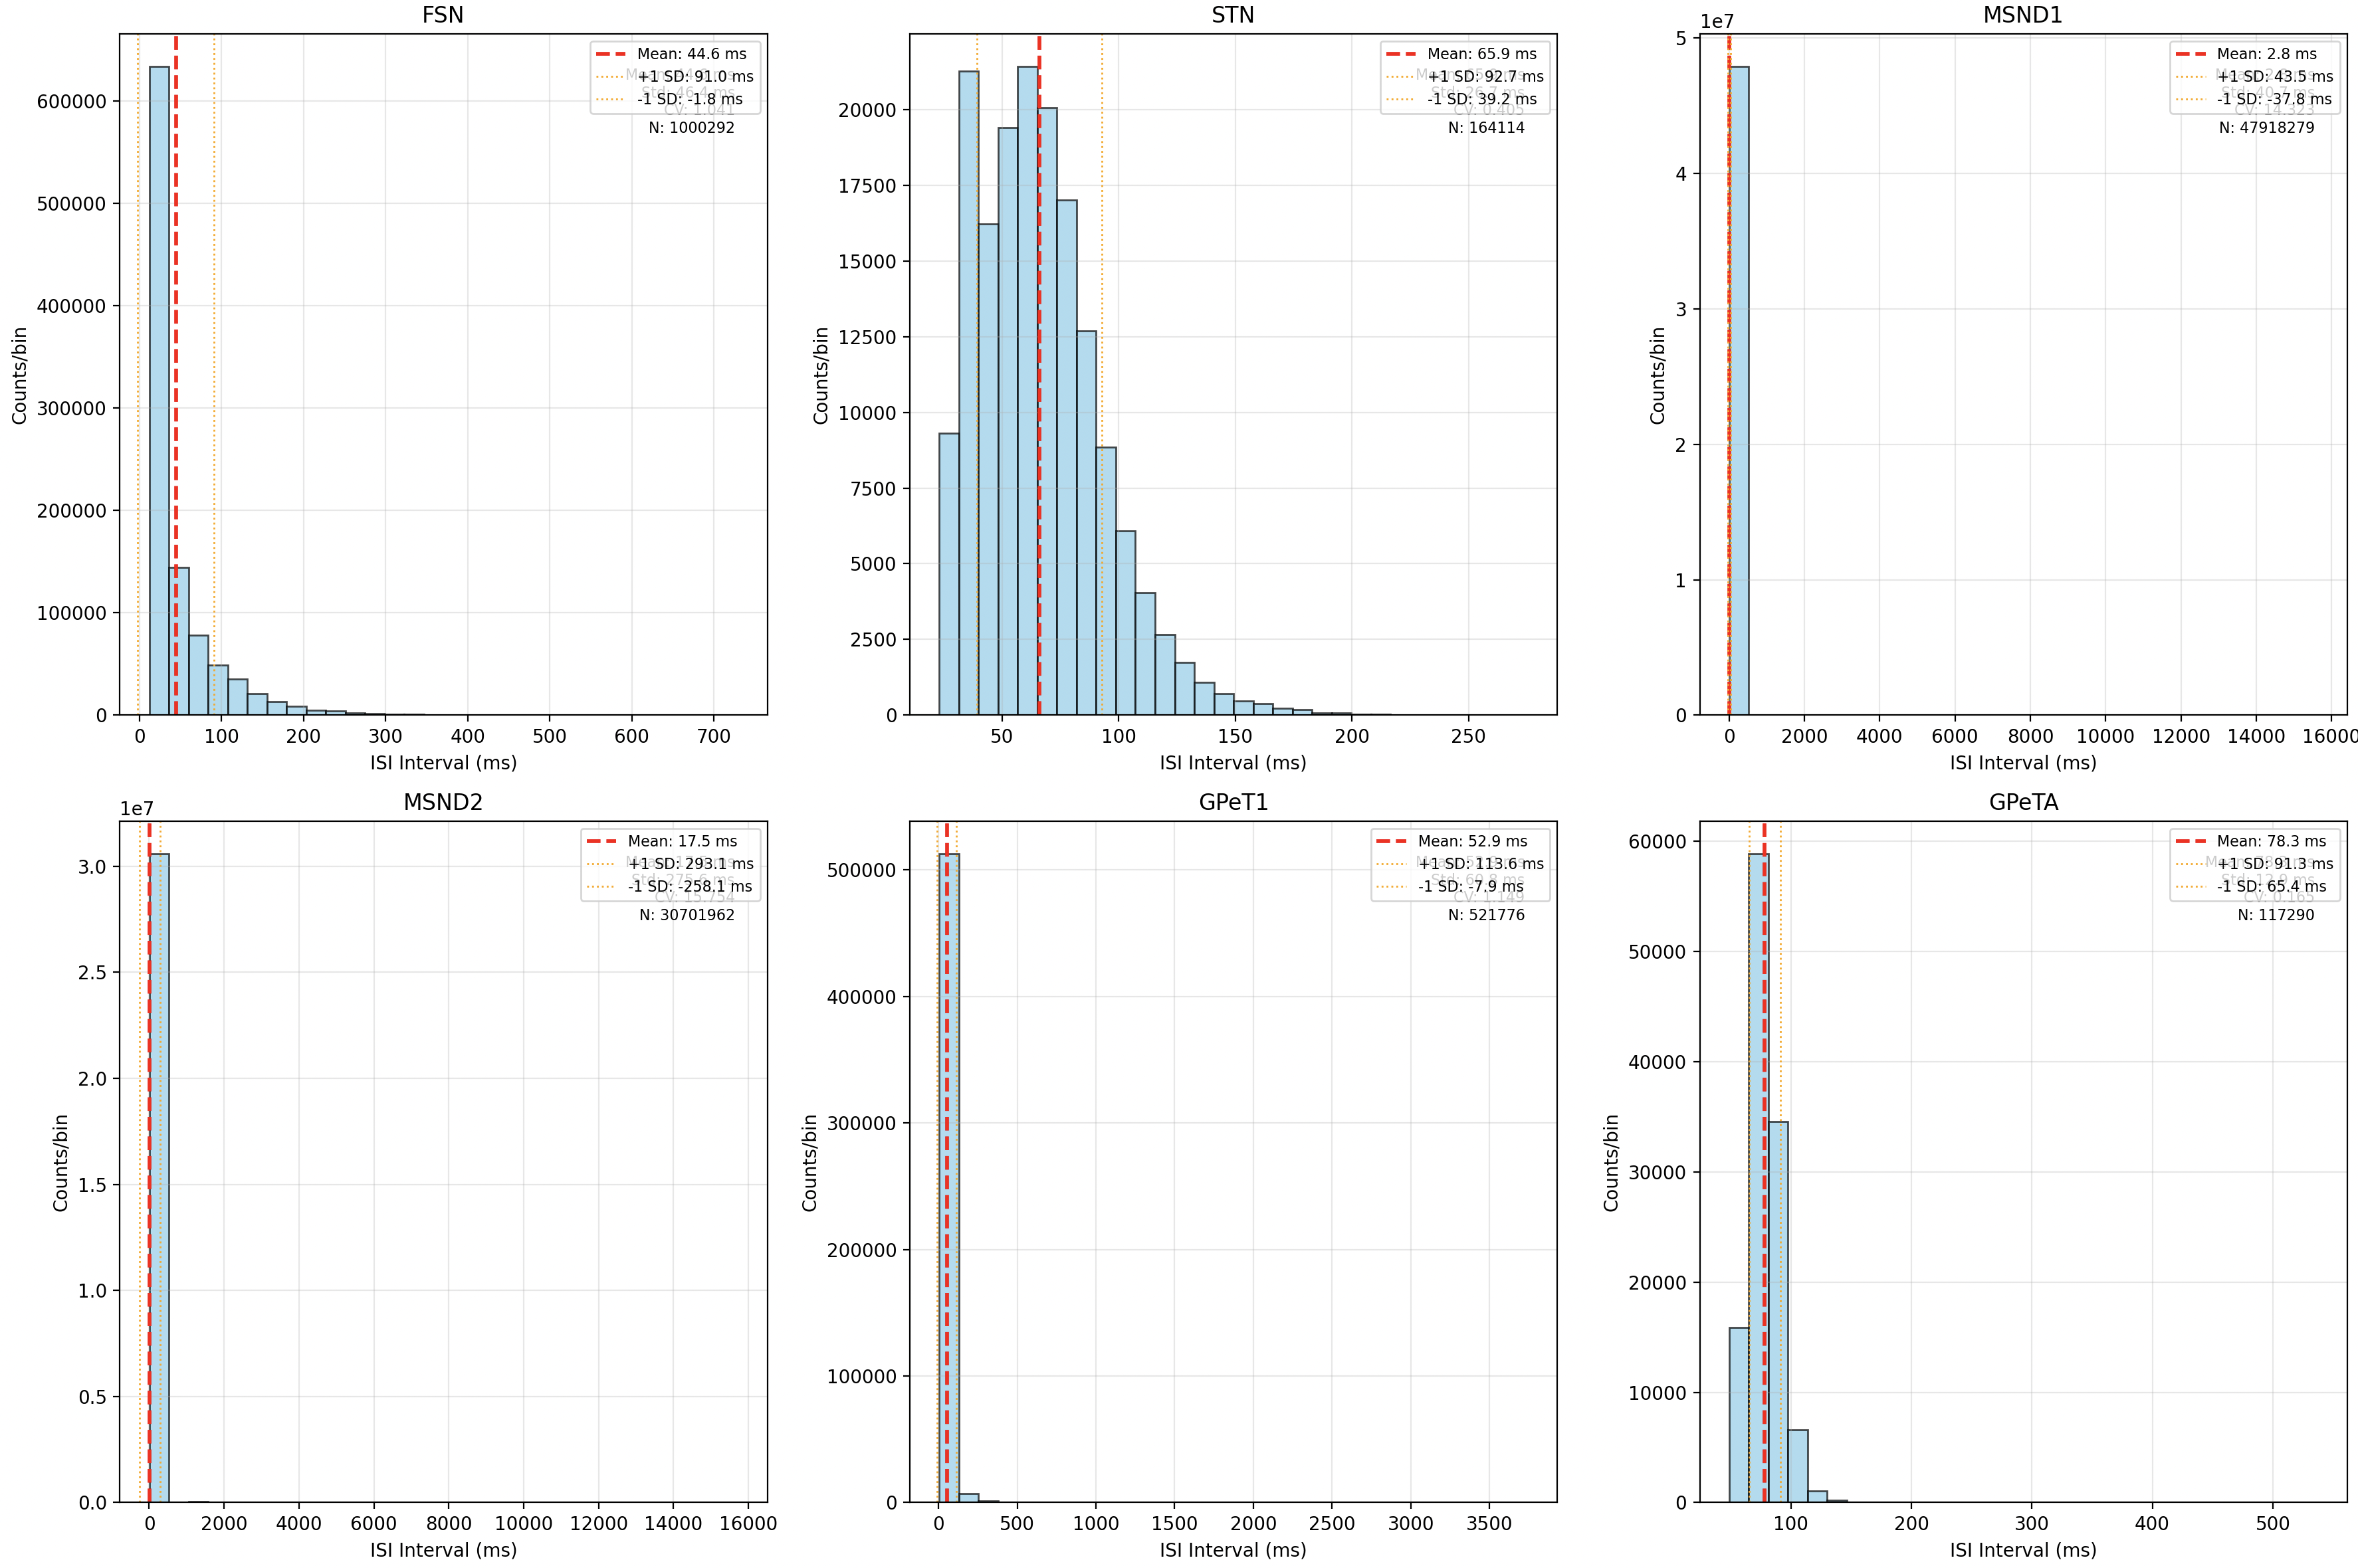
예전 결과들
250707
Normal (3s stimulus)

Slide 11
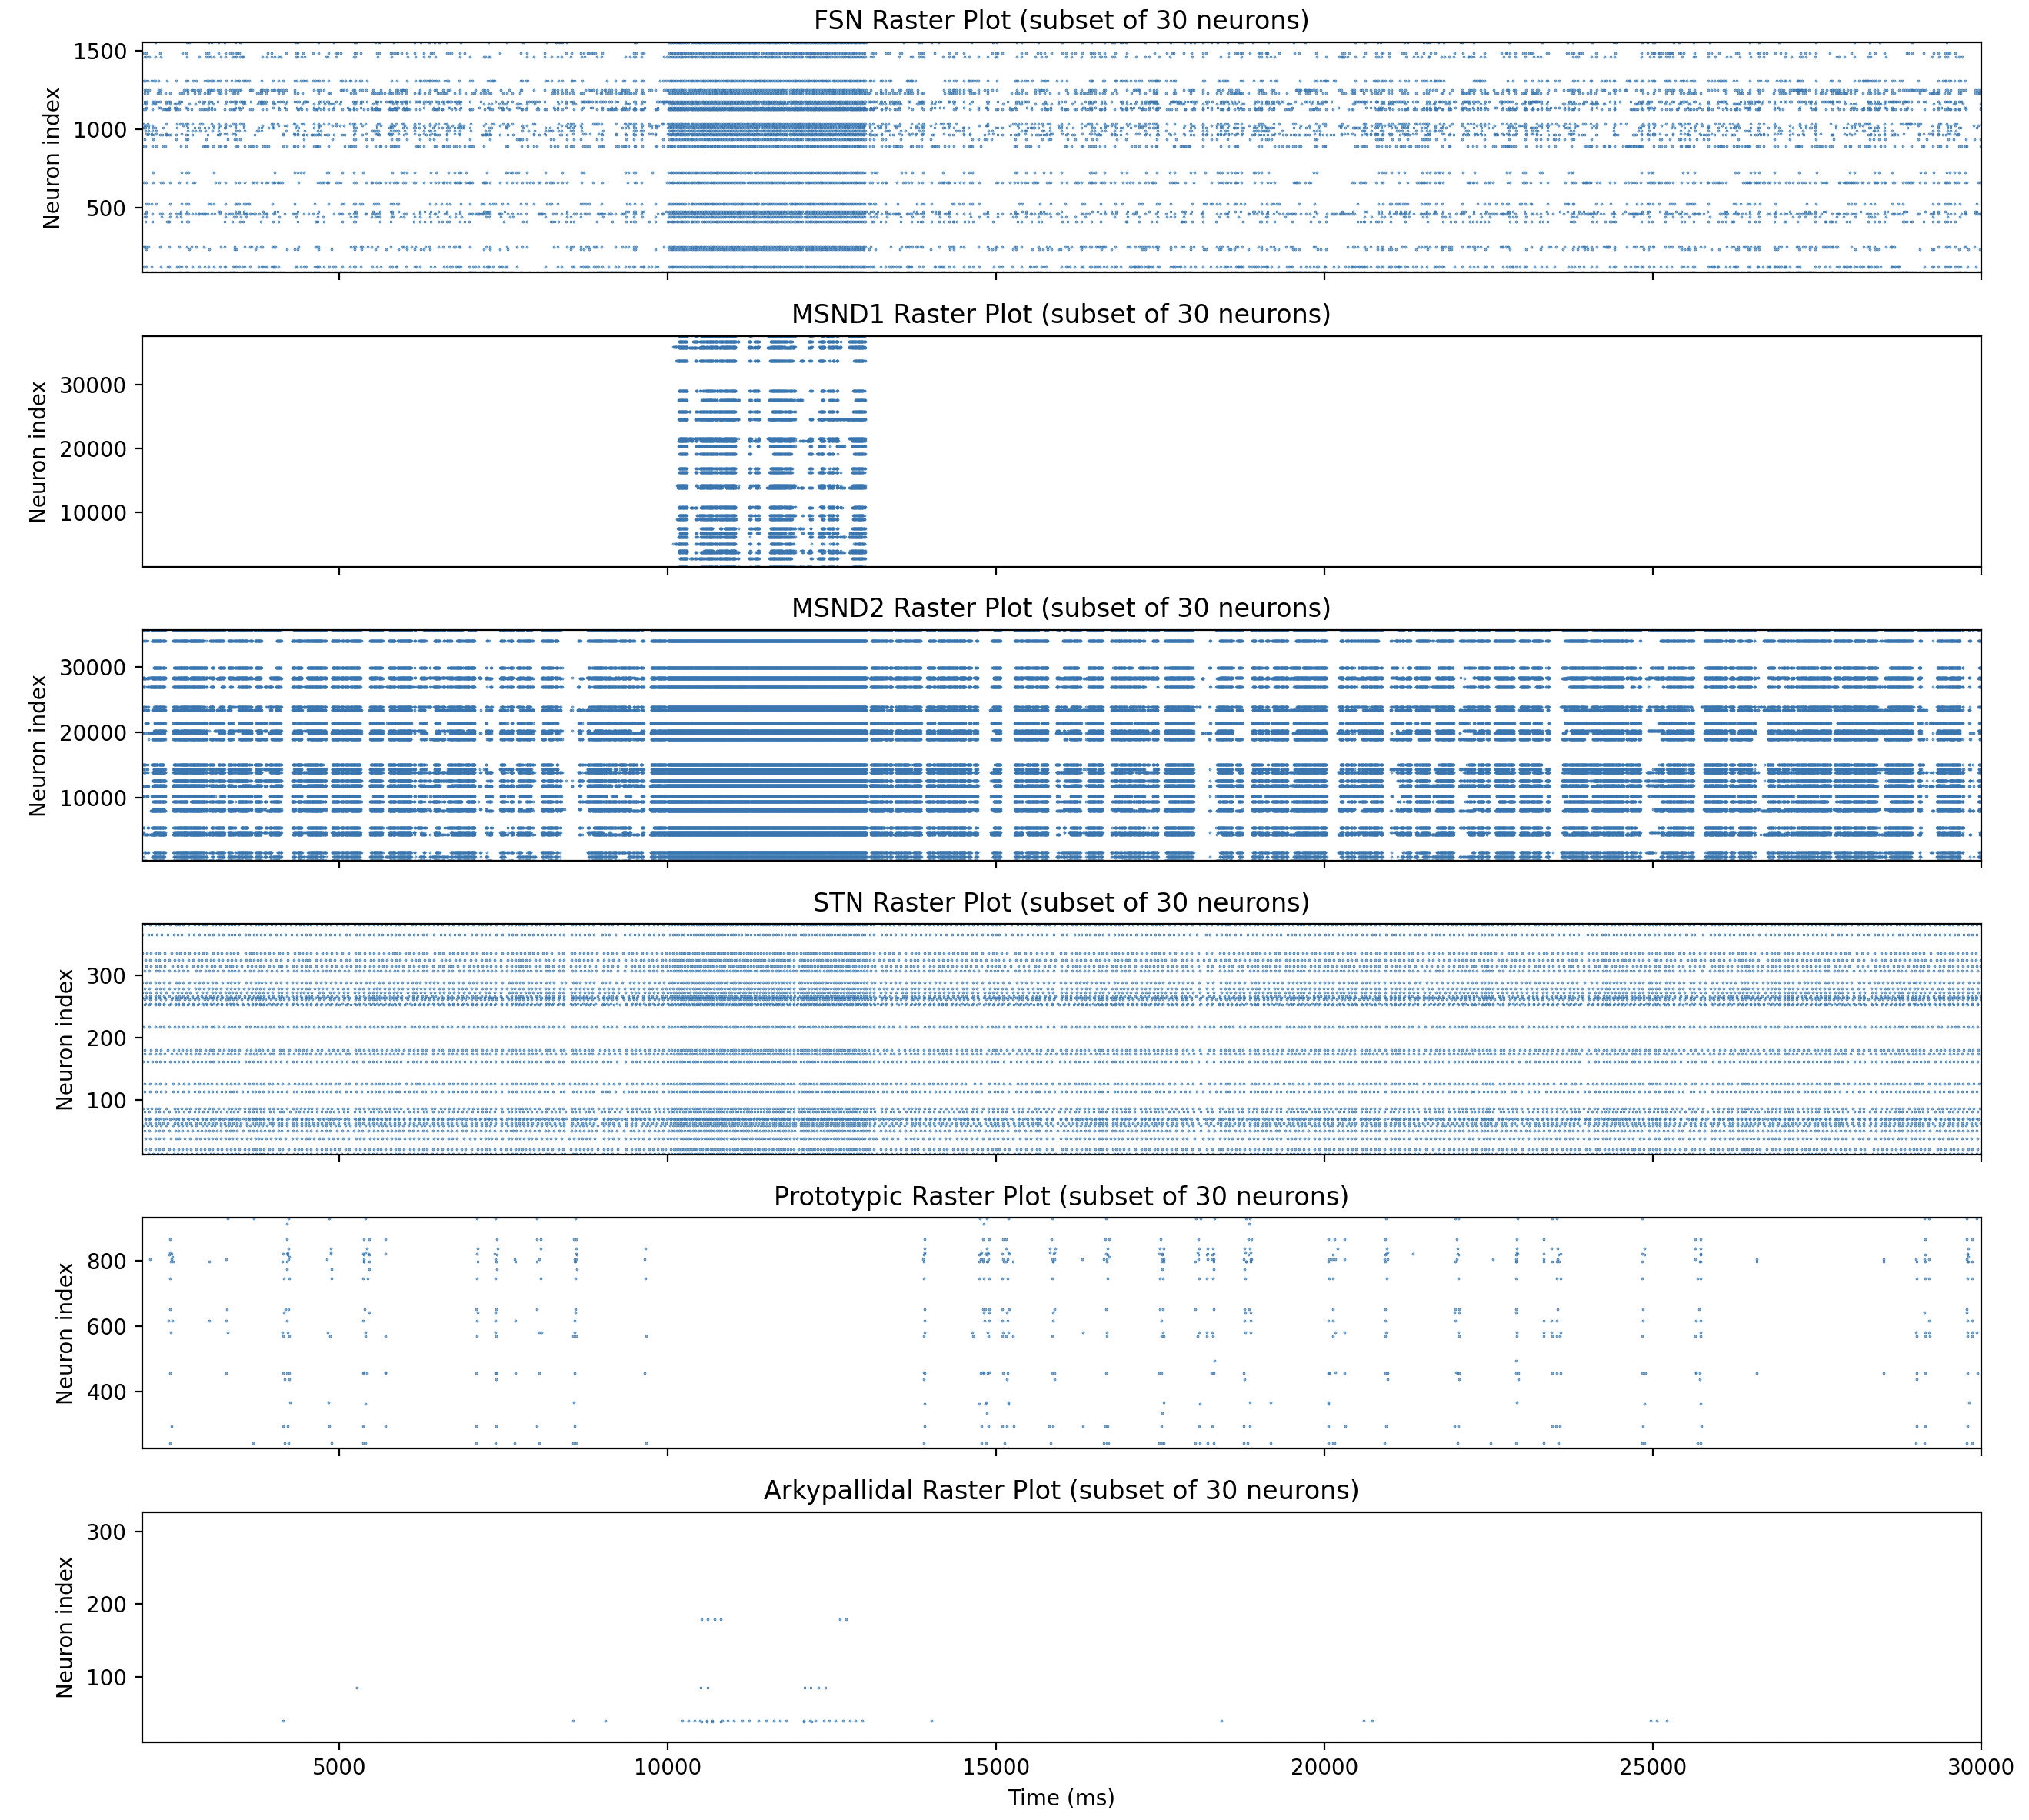
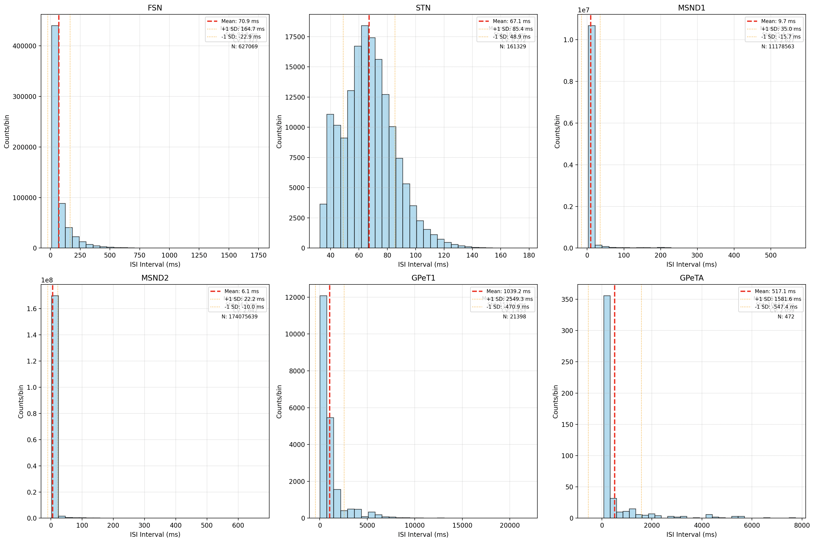
예전 결과들
250707
PD (3s stimulus)

